Slide 1
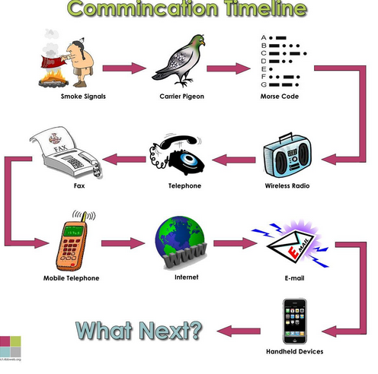
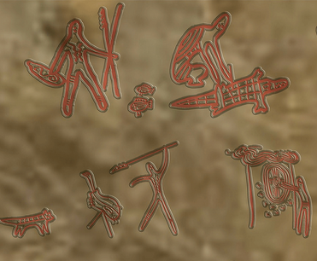
Brief Communication Timeline
Communication is the process of exchanging words, signs, or information with others. It is done either verbally or non-verbally.
Early cave paintings
Peter J Faulks A History of Communication Slide 1

Slide 2
Modern Communication
Note Nikola Tesla had invented
Electricity
Networks created
1910
Peter J Faulks A History of Communication Slide 2

Slide 3
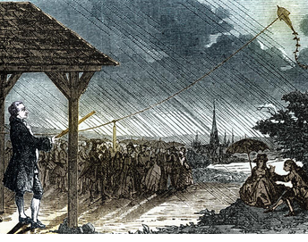
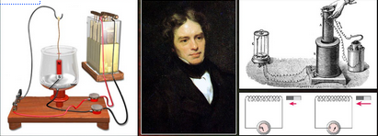
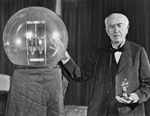
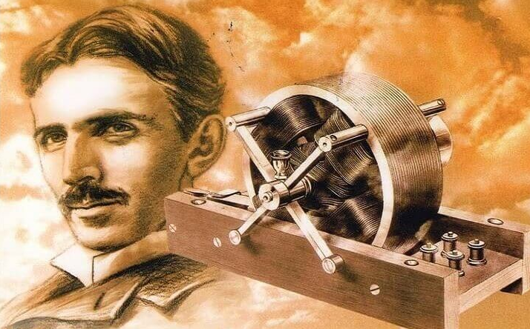
Modern Communication Electricity
1752. Benjamin Franklin discovered electricity with his famous
kite-flying experiments
1833 Michael Faraday, was the first one to realize that an electric current
could be produced by passing a magnet through a copper wire.
He invented the first electric motor and dynamo,
demonstrated the relation between electricity and
chemical bonding, discovered the effect of magnetism
on light, and discovered and named diamagnetism.
1879 Thomas Edison focused
on inventing a practical light bulb, one that would last a long time before burning out. He used Direct Current (DC = Batteries etc.)
Nikola Tesla May of 1888
After receiving a patent on the electric transmission
Of power Tesla subsequently demonstrated
alternating current electricity in 1893.Tesla discovered the rotating magnetic field and created the alternating current
electrical system Alternating Current – Used world
wide today Europe 240 volts, USA 110 volts system.
Nikola Tesla
Peter J Faulks A History of Communication Slide 3

Slide 4
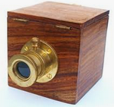
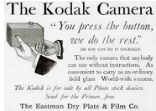
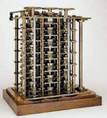
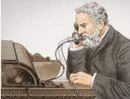
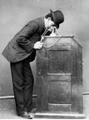
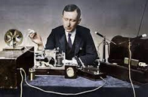
A History of Communication
3 million years ago Speech
2 Million years ago Hand Signals
1 Million Years ago Fires Smoke Signals
200BC Flags land & Sea
Camera was invented by Frenchman Joseph Nicéphore Niépce.
Cameras invented and marketed by George Eastman (1854–1932)
1822 Computers Charles Babbage invents a computer, but computers
were was not built until 1940’s Alan Turing invented computer science.
Domestic computers 1990’s Apple & Windows appeared 1991 onwards
1877 on Heliograph Mirrors Lights
1844 May 24 Morse Code invented
March 1876, Alexander Bell Telephone
1891 the Edison Company successfully
demonstrated a prototype of the Kinetoscope
1895, Guglielmo Marconi Wireless
1941 on Mobile Communication established using short wave wireless
1965 – Chandros Rypinski, Jr. patents the first multiple channel radio telephone system
Peter J Faulks A History of Communication Slide 4

Slide 5
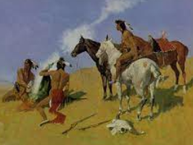
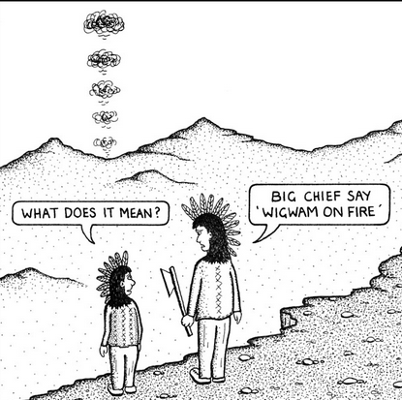
A History of Communication
When humans began to talk around 500,000 BCE communication began.
symbols and images were being used to portray information and languages developed. However this was short distance communication we had to be in earshot of our friends, so hand signals developed which could be seen from a distance various developments occurred
Smoke signals were used by many cultures including the Native Americans a very long time ago. It is one of the oldest forms of visual, long distance communication. Messages of warning, help and important news were sent in messages using smoke signals.
Usually a call for help was a beacon fire on a hill
Peter J Faulks A History of Communication Slide 5

Slide 6
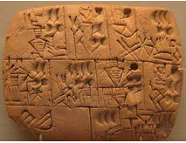
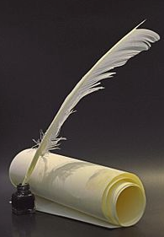
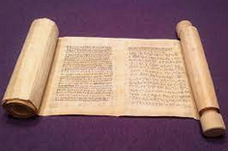
Written Communication
Messages were sent by hand written on scrolls of papyrus, or hammered on clay tablets or rocks
The history of scrolls dates back to ancient Egypt. In most ancient literate cultures scrolls were the earliest format for longer documents written in ink or paint on a flexible background, preceding bound books; rigid media such as clay tablets were also used but had many disadvantages in comparison.
As far as components go, ink is made up of two key parts: the pigment and the carrier. The pigment is the dye itself, and is what is delivered by the vessel to the paper or printing medium (paper). Using feather cut at an angle they dipped the tip into an ink pot made up of crushed beetles or any dye and wrote a letter.
Peter J Faulks A History of Communication Slide 6

Slide 7
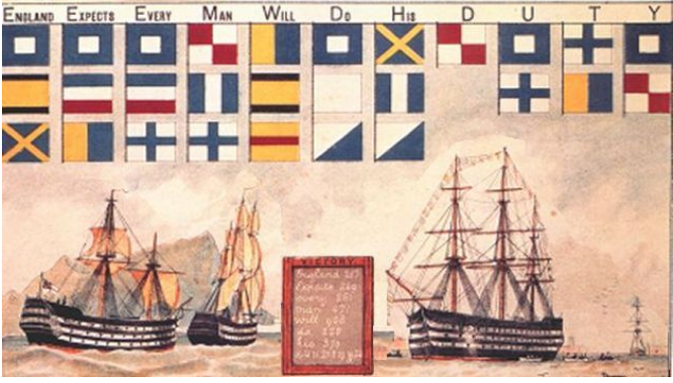
A History of Communication
Other ways of communication began, these included Flags on sticks, flags on ships, mirrors and heliograph
A heliograph (from Greek 'sun’ and 'write') is a semaphore system that signals by flashes of sunlight (generally using a pre-arranged code or later Morse code) reflected by a mirror. The flashes are produced by momentarily pivoting the mirror, or by interrupting the beam with a shutter.
Ships used flags the most famous signal being
Peter J Faulks A History of Communication Slide 7

Slide 8
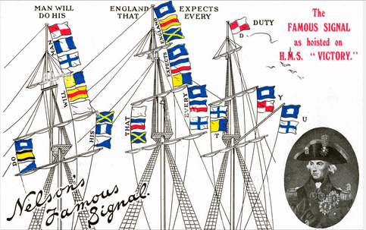
Flag Communication
So by the 19th Century we had some crude communication
England expects that every man will do his duty
Peter J Faulks A History of Communication Slide 8

Slide 9
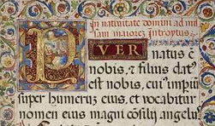
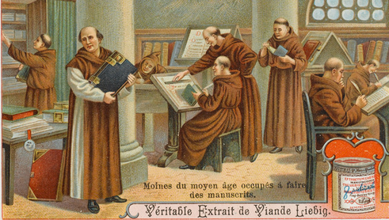
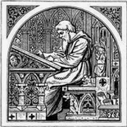
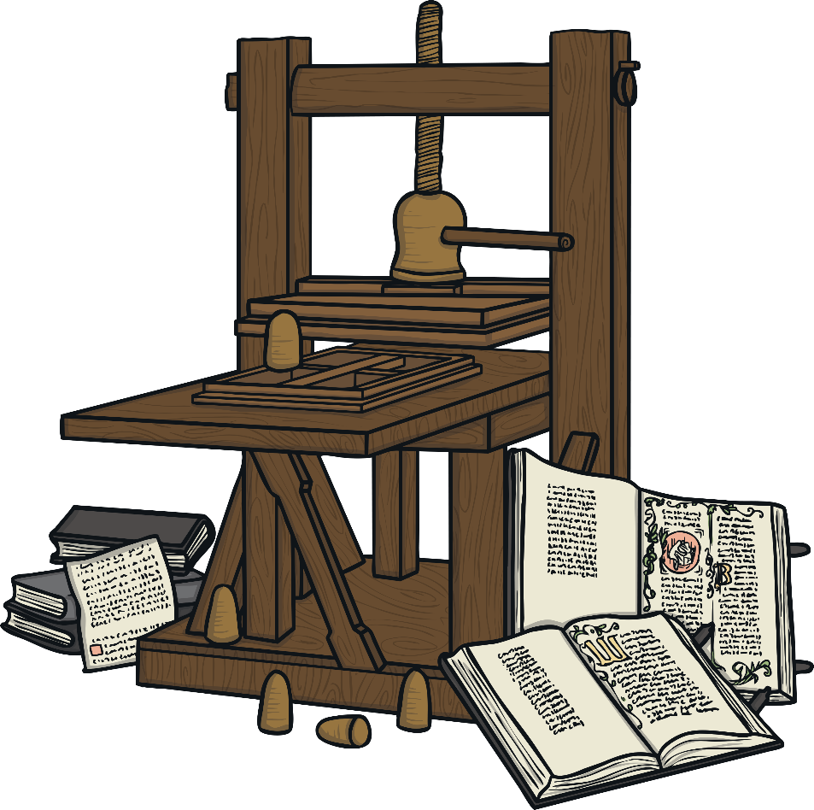
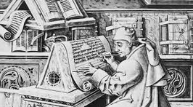
A History of Communication
Monks & Priests usually copied written works, taking years to complete one book, using ink and paints
But In the 1440s, a man named Johann Gutenberg invented a machine that could print many books quickly. Before this time, books were handwritten and this meant that there were not many books available to buy or read. With the invention of the printing press we could communicate reading
news sheets and later newspapers and magazines by
1450, we had a printing
Machine perfected and
Ready to use
commercially:
The Gutenberg press
Peter J Faulks A History of Communication Slide 9

Slide 10
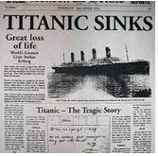
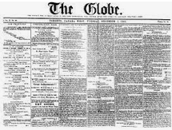
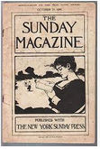
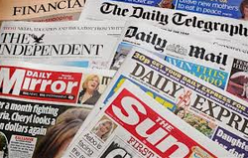
A History of Printed Communication
Early Newspapers were crowded full of mainly text
1912 News
1899 Magazine
Modern newspapers
Peter J Faulks A History of Communication Slide 10

Slide 11
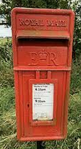
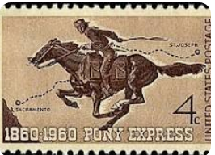
Paper Communication
People used pen and paper to write letters and this was a very popular way of communicating. In the 1800s, official postal systems were set up all over the world, to deliver letters and parcels. However, sometimes the system was unreliable because it took a long time for a letter to reach its destination and sometimes letters could be lost and never arrived at their destination.
The invention of paper replace parchment scrolls
and we saw the beginnings of letter post
The Pony Express was an American express mail service that used relays of horse-mounted riders. It operated from April 3, 1860, to October 26, 1861, between Missouri and California. It was operated by the Central Overland California and Pikes Peak Express Company.
A carrier pigeon is a pigeon that has been trained to carry messages from one point to its home. A message is attached to the pigeon’s foot. Carrier pigeons
were used in the First World War so that people were not at risk delivering important messages through war zones.
Peter J Faulks A History of Communication Slide 11

Slide 12
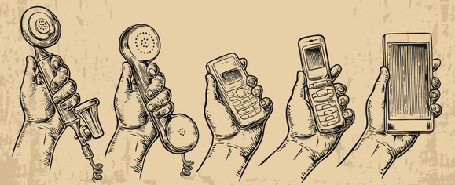
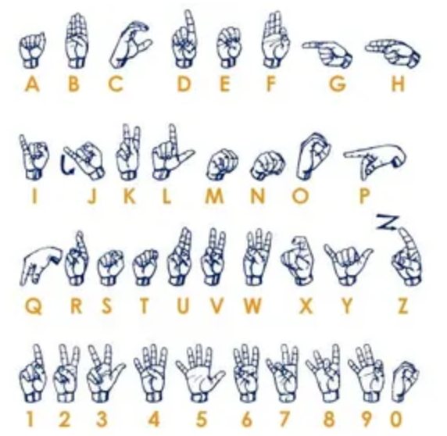
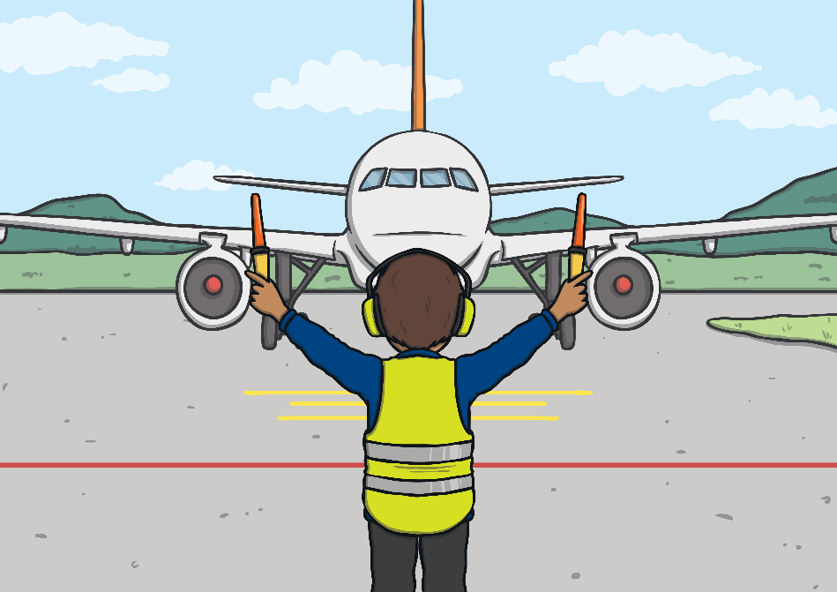
Mobile Communication
Hand signals
Hand signals (called sign language) are commonly used by people who are deaf. However, many people use other hand signals in their daily lives, especially in their work. For example, a ground handler directs an airplane to its parking position and a police officer uses hand signals when directing traffic.
https://designanddigitaltechnology.wordpress.com/2014/06/06/communicationtechnology/
Peter J Faulks A History of Communication Slide 12

Slide 13
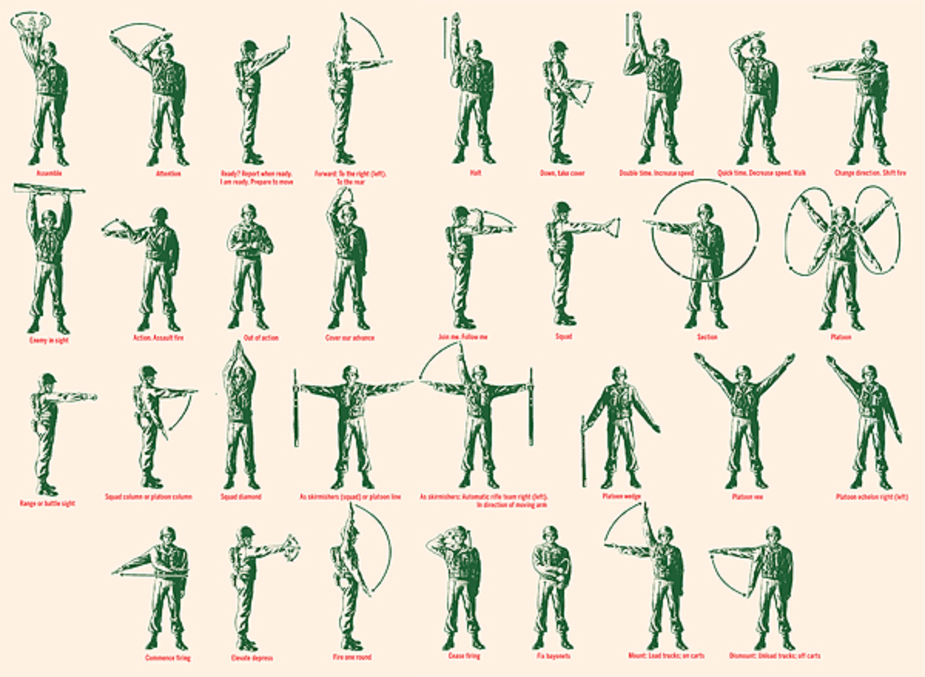
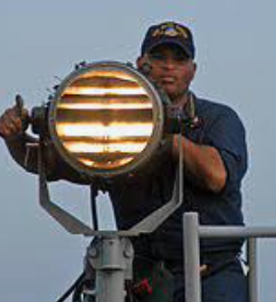
Mobile Communication
Hand
Signals
Army
Navy use
heliograph
https://designanddigitaltechnology.wordpress.com/2014/06/06/communicationtechnology/
Peter J Faulks A History of Communication Slide 13

Slide 14
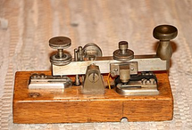
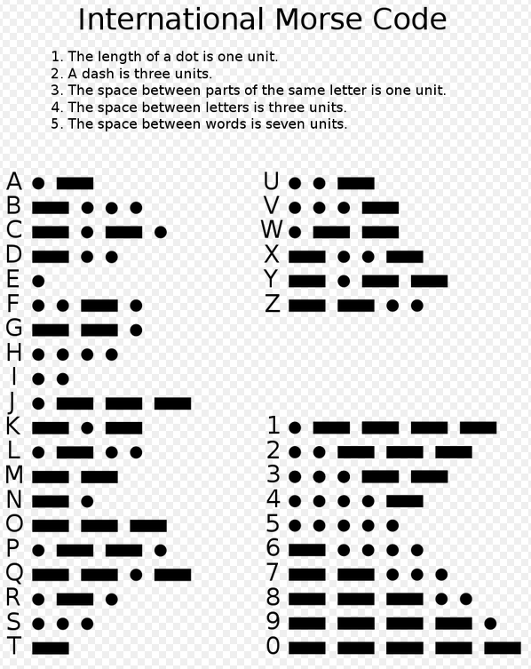
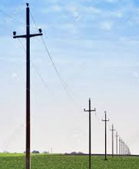
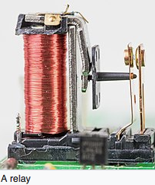
Networks
When did networks begin Morse Code
Radiotelegraphy and aviation. In the 1890s, Morse code began to be used extensively for early radio communication before it was possible to transmit voice. In the late 19th and early 20th centuries, most high-speed international communication used Morse code on telegraph lines, undersea cables, and radio circuits. Morse developed the concept of a single-wire telegraph.
In time, the Morse code that he developed would become the primary language of telegraphy in the world.
Cooke and Wheatstone formed a partnership and patented the electrical telegraph in May 1837, and within a short time had provided the Great Western Railway with a 13-mile (21 km) stretch of telegraph. However, within a few years, Cooke and Wheatstone's multiple-wire signaling method would be overtaken by Morse's cheaper method.
Morse encountered the problem of getting a telegraphic signal to carry over more than a few hundred yards of wire. Morse introduced extra circuits or relays at frequent intervals and was soon able to send a message through ten miles (16 km) of wire.
Wire Poles carry signals
16 May 2022 Peter J Faulks Slide 14

Slide 15
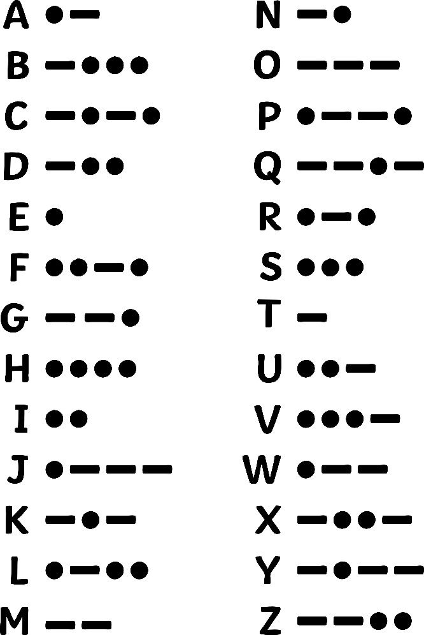
A History of Communication
Morse - Electrical Telegraph
In the 1800s, telegraphic communication was invented which involved sending electric signals through a wire. A well-known version of the electrical telegraph is Morse code. Morse’s code used dots and dashes, which were short and long pulses, sent through the wire to match letters and numbers.
This type of communication allowed for instant communication across very long distances, which was something that had never been done before.
Peter J Faulks A History of Communication Slide 15

Slide 16
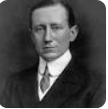
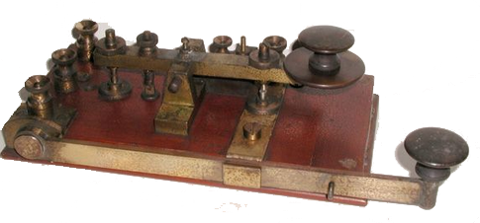
Networks
Marconi spark key used on Titanic
When did networks begin - Marconi
Marconi was convinced that communication among people was possible via wireless radio signalling. In 1895, he began to experiment at his father's home in Pontecchio, where he was soon able to send signals over one and a half miles.
https://en.wikipedia.org/wiki/Guglielmo_Marconi
Titanic The role played by Marconi Co. wireless in maritime rescues raised public awareness of the value of radio and brought fame to Marconi, particularly the sinking of the RMS Titanic on 15 April 1912 RMS Titanic radio operators Jack Phillips and Harold Bride were not employed by the White Star Line but by theMarconi International Marine Communication Company. After the sinking of Titanic on 15 April 1912, survivors were rescued by the RMS Carpathia of the Cunard Line. The Carpathia took a total of 17 minutes to both receive and decode the SOS signal sent by the Titanic. There was a distance of 58 miles between the two ships. After this incident, Marconi gained popularity and became more recognised for his contributions to the field of radio and wireless technology S O S Became the universal signal for help. All ships had to keep their radios on at all times.
For aircraft The "mayday" procedure word was conceived as a distress call in the early 1920s by Frederick Stanley Mockford, officer-in-charge of radio at Croydon Airport, England. He had been asked to think of a word that would indicate distress and would easily be understood by all pilots and ground staff in an emergency.
16 May 2022 Peter J Faulks Slide 16

Slide 17
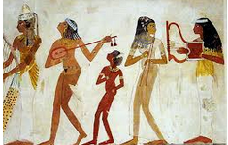
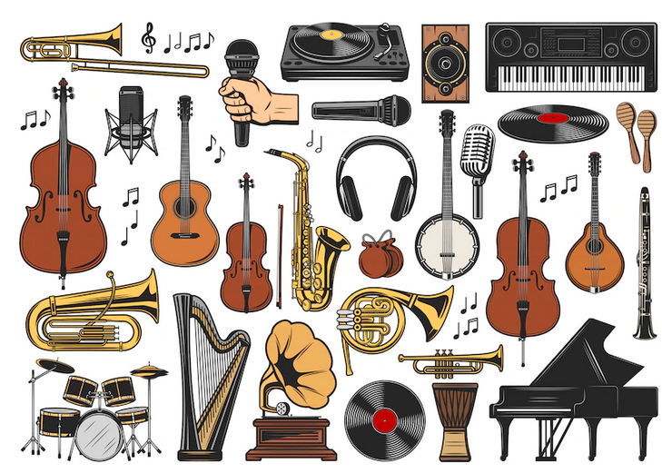
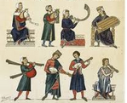
A History of Music
Music was created thousands of years ago
The first-ever written piece of music, presented in a cuneiform “alphabet”, was found in Syria and it probably dates back to 3400 years ago. Usually music was created probably drum-based, percussion instruments being the most readily available at the time (i.e. rocks, sticks). Then a flute and eventually other instruments appeared. Leading to great musicians and orchestras
Peter J Faulks A History of Communication Slide 17

Slide 18
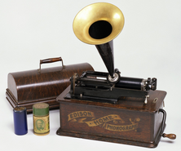
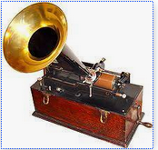
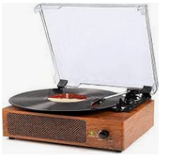
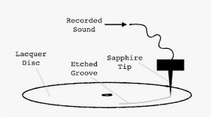
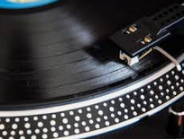
A History of Music
Music was produce for listeners about two hundred years ago
Early music was first transmitted after after Edison invented the phonograph in 1877 invention of the first phonograph, Edison established the Edison Phonograph Company. After making many improvements, it produced spring-powered phonographs in great numbers. These phonographs, equipped with trumpet-type
horns and called “suitcase” phonographs,
Then music was recorded on disc 78rpm, 45rpm and 33rpm
Peter J Faulks A History of Communication Slide 18

Slide 19
A History of Communication
Radio Crystal Tuning, Radio Wireless
Early radios relied on a frequency and a tuner to tune into the signal, thanks to Marconi
Radios send messages by radio waves in the air, instead of through wires. In the early 1920s, people spent hours listening to stations that were broadcasting news, music, sports, drama and variety shows.
As radios further developed we added tape recording for the first multimedia devices Ghetto Blasters
Peter J Faulks A History of Communication Slide 19

Slide 20
A History of Communication
Tape to digital
Reel to reel tape recorder appeared and then 8 track tape discs then Cassette Tape and eventually CD Rom and DVD to digital using Binary code to convert sounds to computer base sounds.
Reel to Reel recorder
8 Track Disc
Cassette Tape
Digitized music
CD Discs
Peter J Faulks A History of Communication Slide 20

Slide 21
A History of Communication
Telephone using line communication
In the late 1800s, a man named Alexander Graham Bell invented the first telephone using wire to transmit voices over long distances.
Early phones needed to be fixed with wires
Peter J Faulks A History of Communication Slide 21

Slide 22
A History of Communication Camera & Film
1890’s Movies Silent and Black & White
1920’s Movies Sound and Black & White
1940’s - 60’s Movies
Sound and Colour
The Jazz Singer
Wizard of Oz
1960’s Movies Sound and Colour Todd A O
3DTechnology
Peter J Faulks A History of Communication Slide 22

Slide 23
A History of Communication
Brick Phone to Mobile Telephone
But with modern technology, telephone calls can be sent through radio waves or satellites, which makes them cordless.
Modern mobile phones can not only make phone calls but they can be used for text messaging, taking photos, playing games and accessing the Internet. Over the years, phones have also become smaller and lighter to carry. These days, people can not only hear each other talking, but they have a small screen that allows people to see each other as well.
Peter J Faulks A History of Communication Slide 23

Slide 24
A History of Communication
Television
The invention of television in the 1920s was a breakthrough in technology because it was the first time sound and pictures could be sent over the air. At first, television images were only displayed in black and white and it wasn’t until the 1970s that people could see colour on the screen.
Peter J Faulks A History of Communication Slide 24

Slide 25
A History of Communication
Television
In 1990, LED (Liquid Crystal Display) TV appeared, leading to larger flatter screens Despite having a different acronym, LED TV is just a specific type of LCD TV, which uses a liquid crystal display (LCD) panel to control where light is displayed on your screen. These panels are typically composed of two sheets of polarizing material with a liquid crystal solution between them.
An OLED display uses a panel of pixel-sized organic compounds that respond to electricity. Since each tiny pixel (millions of which are present in modern displays) can be turned on or off individually, OLED displays are called “emissive” displays (meaning they require no backlight).
Peter J Faulks A History of Communication Slide 25

Slide 26
A History of Communication
Computers 1970’s
In the early 1940s, the first electric computer was created but it was very large and not like the computers we use today. Since then, inventors have transformed the way computers work so that they are faster, more mobile, more powerful and multifunctional.
Peter J Faulks A History of Communication Slide 26

Slide 27
A History of Communication
Computers 1980’s
A range of new computers hit the market like the
Commodore 64. and more famous the Apple II
Others include :- ZX Spectrum., IBM PC 5150.
Apple Macintosh. Commodore VIC-20.
Amstrad CPC 464., BBC Micro., ZX Spectrum +2.
Floppy 5”
Drive
Apple II who is this?
Commodore 64
Amstrad CPC 464.
Peter J Faulks A History of Communication Slide 27

Slide 28
A History of Communication
Computers 1980’s
Along with the invention of the Internet in the 1990s, people became interconnected through computer networks that link computers worldwide. There are many popular ways of communication over the internet, such as email, social networking and instant messaging.
Peter J Faulks A History of Communication Slide 28

Slide 29
Computers 2000’s
Along with the invention of the Internet in the 1990s, people became interconnected through computer networks that link computers worldwide. There are many popular ways of communication over the internet, using a modem to convert signals this enables communication via email, social networking and instant messaging.
Modem
Peter J Faulks A History of Communication Slide 29

Slide 30
A History of Communication
What next in the 21st Century?
You can now use a hand held device that can record sound, take amazing images, record video and send it instantly around the world. You can communicate with anyone (with another phone) anywhere in the world at any time!
The End or is it just the beginning?
Peter J Faulks A History of Communication Slide 30

